Slide 1
MapReduce

Slide 2
Motivation
Process lots of data
Google processed about 24 petabytes of data per day in 2009.
A single machine cannot serve all the data
You need a distributed system to store and process in parallel
Parallel programming?
Threading is hard!
How do you facilitate communication between nodes?
How do you scale to more machines?
How do you handle machine failures?

Slide 3
MapReduce
MapReduce [OSDI’04] provides
Automatic parallelization, distribution
I/O scheduling
Load balancing
Network and data transfer optimization
Fault tolerance
Handling of machine failures
Need more power: Scale out, not up!
Large number of commodity servers as opposed to some high end specialized servers
Apache Hadoop:
Open source implementation of MapReduce

Slide 4
Typical problem solved by MapReduce
Read a lot of data
Map: extract something you care about from each record
Shuffle and Sort
Reduce: aggregate, summarize, filter, or transform
Write the results

Slide 5
MapReduce workflow
Input Data
Output Data
Worker
write
Output
File 0
local
write
Worker
Split 0
read
Split 1
Worker
Split 2
Output
File 1
Worker
Worker
remote
read,
sort
Map
extract something you care about from each record
Reduce aggregate, summarize, filter, or transform

Slide 6
Mappers and Reducers
Need to handle more data? Just add more Mappers/Reducers!
No need to handle multithreaded code ☺
Mappers and Reducers are typically single threaded and deterministic
Determinism allows for restarting of failed jobs
Mappers/Reducers run entirely independent of each other
In Hadoop, they run in separate JVMs

Slide 7
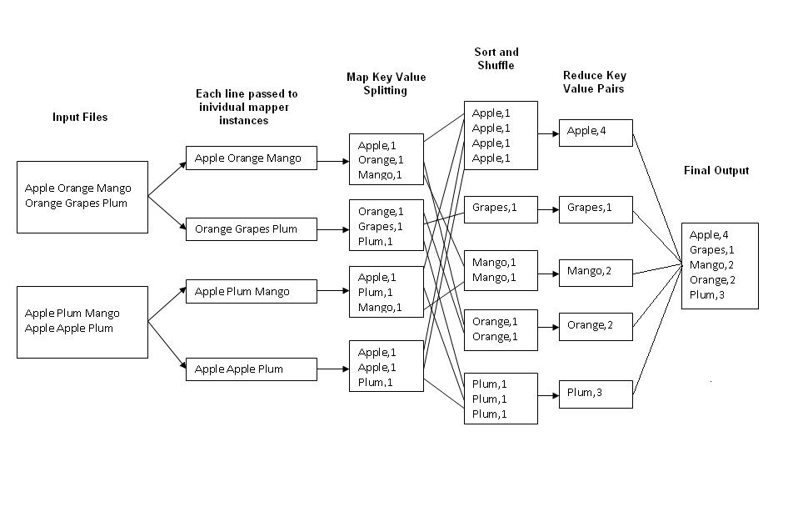
Example: Word Count
(2012)
Average Searches Per Day:
5,134,000,000
1000 nodes: each node will process 5,134,000 queries
http://kickstarthadoop.blogspot.ca/2011/04/word-count-hadoop-map-reduce-example.html

Slide 8
Mapper
Reads in input pair <Key,Value>
Outputs a pair <K’, V’>
Let’s count number of each word in user queries (or Tweets/Blogs)
The input to the mapper will be <queryID, QueryText>:
<Q1,“The teacher went to the store. The store was closed; the store opens in the morning. The store opens at 9am.” >
The output would be:
<The, 1> <teacher, 1> <went, 1> <to, 1> <the, 1> <store,1> <the, 1> <store, 1> <was, 1> <closed, 1> <the, 1> <store,1> <opens, 1> <in, 1> <the, 1> <morning, 1> <the 1> <store, 1> <opens, 1> <at, 1> <9am, 1>

Slide 9
Reducer
Accepts the Mapper output, and aggregates values on the key
For our example, the reducer input would be:
<The, 1> <teacher, 1> <went, 1> <to, 1> <the, 1> <store, 1> <the, 1> <store, 1> <was, 1> <closed, 1> <the, 1> <store, 1> <opens,1> <in, 1> <the, 1> <morning, 1> <the 1> <store, 1> <opens, 1> <at, 1> <9am, 1>
The output would be:
<The, 6> <teacher, 1> <went, 1> <to, 1> <store, 3> <was, 1> <closed, 1> <opens, 1> <morning, 1> <at, 1> <9am, 1>
Notes:
Input is typically sorted, output is output exactly as is
All inputs with the same key must go to the same reducer!

Slide 10
MapReduce
Hadoop
Program
fork
fork
fork
Master
assign
map
assign
reduce
Input Data
Output Data
Transfer peta-scale data through network
Worker
write
Output
File 0
local
write
Worker
Split 0
read
Split 1
Worker
Split 2
Output
File 1
Worker
Worker
remote
read,
sort
Map
Reduce

Slide 11
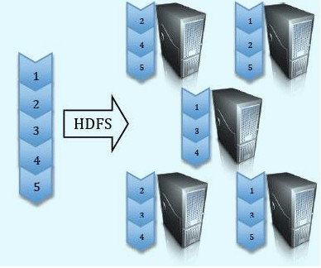
Google File System (GFS) Hadoop Distributed File System (HDFS)
Split data and store 3 replica on commodity servers

Slide 12
MapReduce
HDFS
NameNode
Where are the chunks of input data?
Location of the chunks of input data
Master
assign
map
assign
reduce
Input Data
Output Data
Worker
write
Output
File 0
Split 0
local
write
Worker
Split 0
Split 1
Worker
Split 2
Split 1
Output
File 1
Worker
Read from local disk
Worker
remote
read,
sort
Split 2
Map
Reduce
Notes:
Master scheduling policy:
Asks GFS for locations of replicas of input file blocks
Map tasks scheduled so GFS input block replica are on same machine or same rack
Effect: Thousands of machines read input at local disk speed
Eliminate network bottleneck!

Slide 13
Locality Optimization
Master scheduling policy:
Asks GFS for locations of replicas of input file blocks
Map tasks scheduled so GFS input block replica are on same machine or same rack
Effect: Thousands of machines read input at local disk speed
Eliminate network bottleneck!

Slide 14
Failure in MapReduce
Failures are norm in commodity hardware
Worker failure
Detect failure via periodic heartbeats
Re-execute in-progress map/reduce tasks
Master failure
Single point of failure; Resume from Execution Log
Robust
Google’s experience: lost 1600 of 1800 machines once!, but finished fine

Slide 15
Fault tolerance: Handled via re-execution
On worker failure:
Detect failure via periodic heartbeats
Re-execute completed and in-progress map tasks
Task completion committed through master
Robust: [Google’s experience] lost 1600 of 1800 machines, but finished fine

Slide 16
Refinement: Redundant Execution
Slow workers significantly lengthen completion time
Other jobs consuming resources on machine
Bad disks with soft errors transfer data very slowly
Weird things: processor caches disabled (!!)
Solution: spawn backup copies of tasks
Whichever one finishes first "wins"
Notes:
Effect: Dramatically shortens job completion time

Slide 17
Refinement: Skipping Bad Records
Map/Reduce functions sometimes fail for particular inputs
Best solution is to debug & fix, but not always possible
If master sees two failures for the same record:
Next worker is told to skip the record

Slide 18
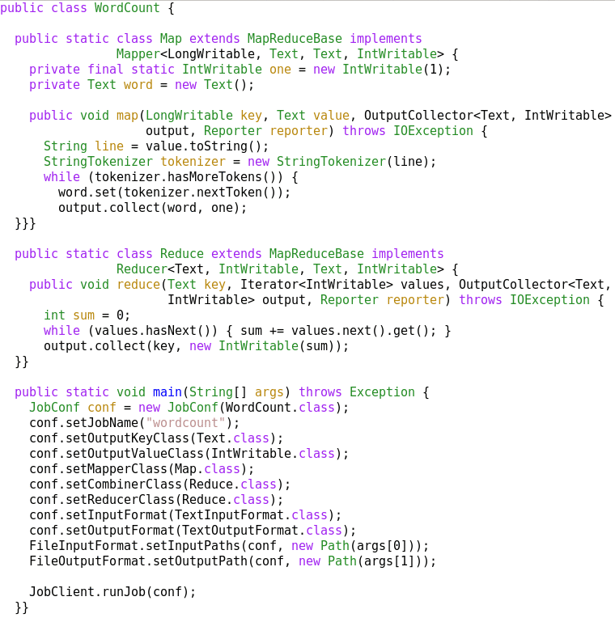
A MapReduce Job
Mapper
Reducer
Run this program as
a MapReduce job

Slide 19
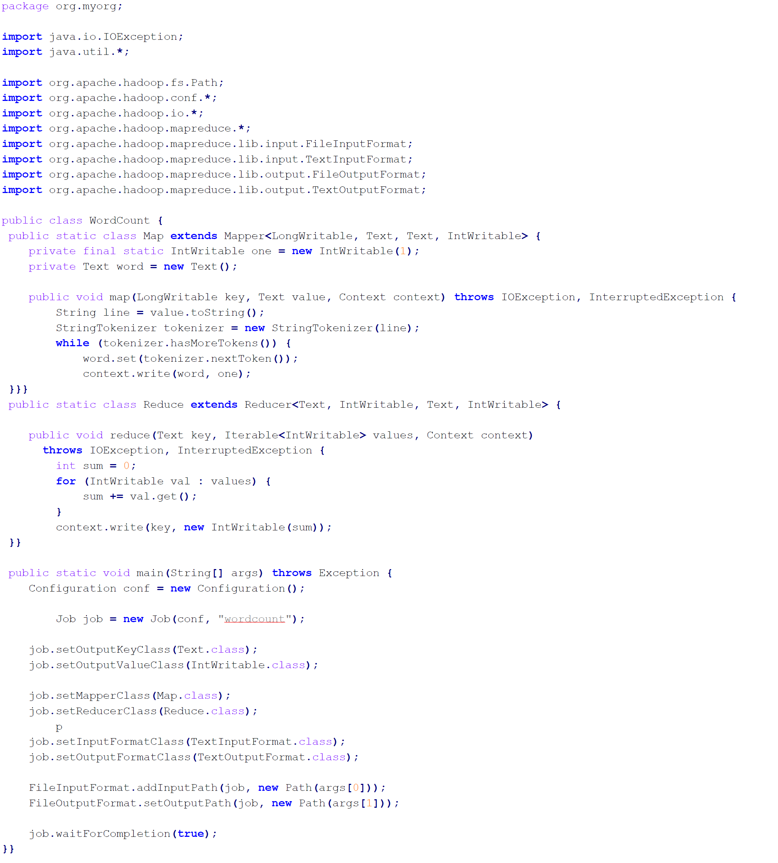
Mapper
Reducer
Run this program as
a MapReduce job

Slide 20
Summary
MapReduce
Programming paradigm for data-intensive computing
Distributed & parallel execution model
Simple to program
The framework automates many tedious tasks (machine selection, failure handling, etc.)

Slide 22
Contents
Motivation
Design overview
Write Example
Record Append
Fault Tolerance & Replica Management
Conclusions

Slide 23
Motivation: Large Scale Data Storage
Manipulate large (Peta Scale) sets of data
Large number of machine with commodity hardware
Component failure is the norm
Goal: Scalable, high performance, fault tolerant distributed file system
Notes:
Symposium on Operating Systems Principles

Slide 24
Why a new file system?
None designed for their failure model
Few scale as highly or dynamically and easily
Lack of special primitives for large distributed computation
Notes:
GFS/HDFS is built on the lessons of the past
Different characteristic than transactional or the “customer order” data : “write once read many (WORM)”

Slide 25
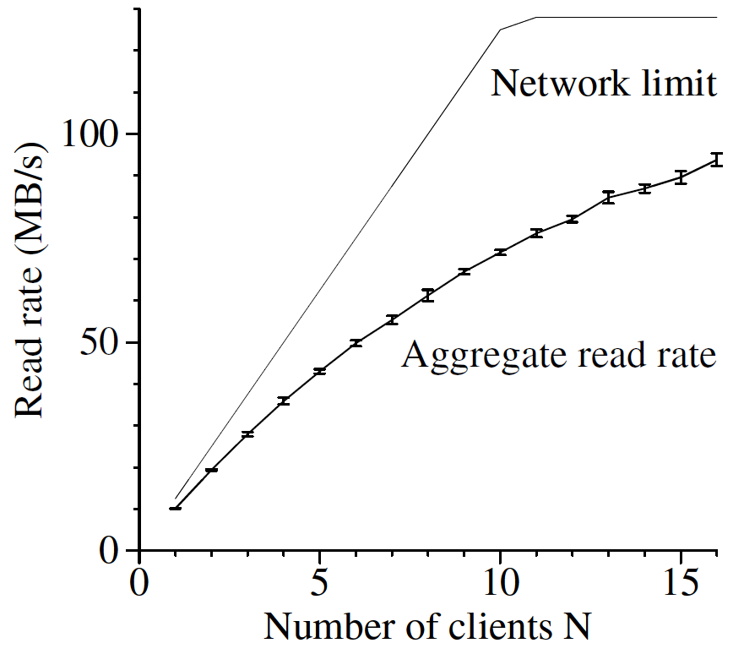
What should expect from GFS
Designed for Google’s application
Control of both file system and application
Applications use a few specific access patterns
Append to larges files
Large streaming reads
Not a good fit for
low-latency data access
lots of small files, multiple writers, arbitrary file modifications
Not POSIX, although mostly traditional
Specific operations: RecordAppend
Notes:
GFS does not need to support any application , e.g. oracle
Has standard read , write

Slide 26
Different characteristic than transactional or the “customer order” data : “write once read many (WORM)”
e.g. web logs, web crawler’s data, or healthcare and patient information
WORM inspired MapReduce programming model
Google exploited this characteristics in its Google file system [SOSP’03]
Apache Hadoop: Open source project

Slide 27
Contents
Motivation
Design overview
Write Example
Record Append
Fault Tolerance & Replica Management
Conclusions

Slide 28
Components
Master (NameNode)
Manages metadata (namespace)
Not involved in data transfer
Controls allocation, placement, replication
Chunkserver (DataNode)
Stores chunks of data
No knowledge of GFS file system structure
Built on local linux file system
www.cse.buffalo.edu/~okennedy/courses/cse704fa2012/2.2-HDFS.pptx

Slide 29
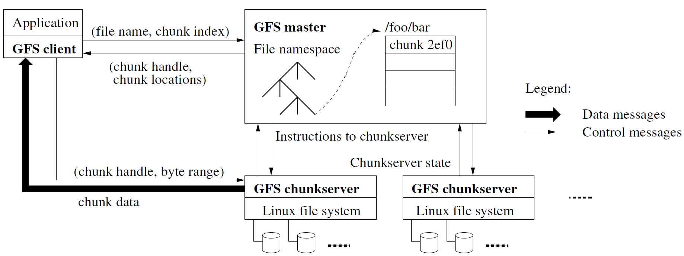
GFS Architecture

Slide 30
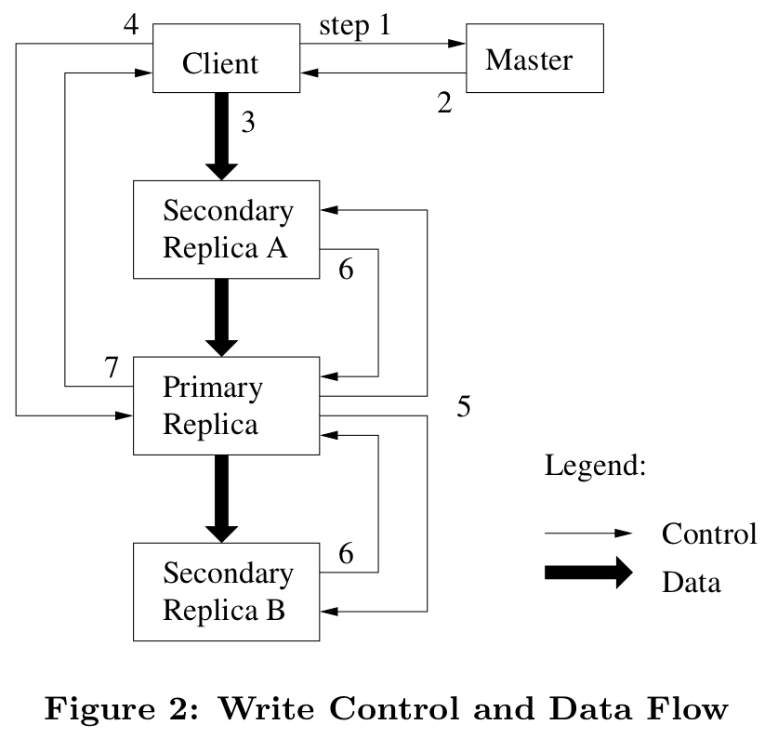
Write operation
Notes:
1- Who has the lease for this chunk of the data
2- After getting the information from master: Client pushes the data in a pipeline fashion

Slide 31
Write(filename, offset, data)
4) Commit
1) Who has the lease?
Master
Client
2) Lease info
3) Data push
Primary Replica
Control
7) Success
Data
3) Data push
6)Commit ACK
Secondary ReplicaA
5) Serialized Commit
3) Data push
6)Commit ACK
Secondary ReplicaB

Slide 32
RecordAppend(filename, data)
Significant use in distributed apps. For example at Google production cluster:
21% of bytes written
28% of write operations
Guaranteed: All data appended at least once as a single consecutive byte range
Same basic structure as write
Client obtains information from master
Client sends data to data nodes (chunkservers)
Client sends “append-commit”
Lease holder serializes append
Advantage: Large number of concurrent writers with minimal coordination
Notes:
Unlike write, no offset
Advantage: many producers and many consumers

Slide 33
RecordAppend (2)
Record size is limited by chunk size
When a record does not fit into available space,
chunk is padded to end
and client retries request.

Slide 34
Contents
Motivation
Design overview
Write Example
Record Append
Fault Tolerance & Replica Management
Conclusions

Slide 35
Fault tolerance
Replication
High availability for reads
User controllable, default 3 (non-RAID)
Provides read/seek bandwidth
Master is responsible for directing re-replication if a data node dies
Online checksumming in data nodes
Verified on reads

Slide 36
Replica Management
Bias towards topological spreading
Rack, data center
Rebalancing
Move chunks around to balance disk fullness
Gently fixes imbalances due to:
Adding/removing data nodes
Notes:
Recent creations used as a proxy for load

Slide 37
Replica Management (Cloning)
Chunk replica lost or corrupt
Goal: minimize app disruption and data loss
Approximately in priority order
More replica missing-> priority boost
Deleted file-> priority decrease
Client blocking on a write-> large priority boost
Master directs copying of data
Performance on a production cluster
Single failure, full recovery (600GB): 23.2 min
Double failure, restored 2x replication: 2min

Slide 38
Garbage Collection
Master does not need to have a strong knowledge of what is stored on each data node
Master regularly scans namespace
After GC interval, deleted files are removed from the namespace
Data node periodically polls Master about each chunk it knows of.
If a chunk is forgotten, the master tells data node to delete it.

Slide 39
Limitations
Master is a central point of failure
Master can be a scalability bottleneck
Latency when opening/stating thousands of files
Security model is weak

Slide 40
Conclusion
Inexpensive commodity components can be the basis of a large scale reliable system
Adjusting the API, e.g. RecordAppend, can enable large distributed apps
Fault tolerant
Useful for many similar apps

Slide 42
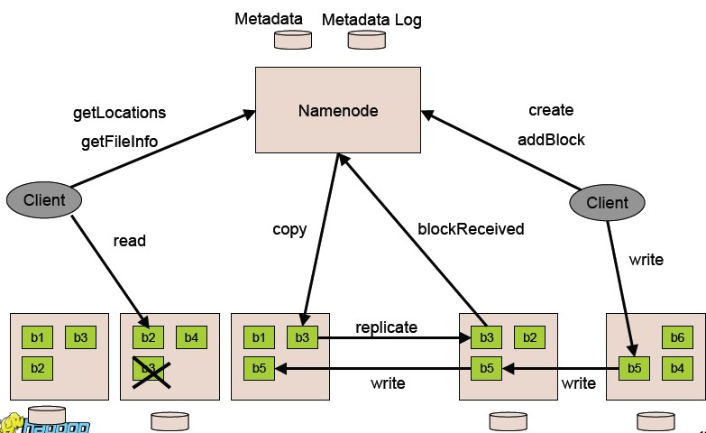
Client read
Client write
Datanode Replication

Slide 43
HDFS Architecture
Client read
Client write
Datanode Replication
http://www.cse.buffalo.edu/~okennedy/courses/cse704fa2012/2.2-HDFS.pptx

Slide 44
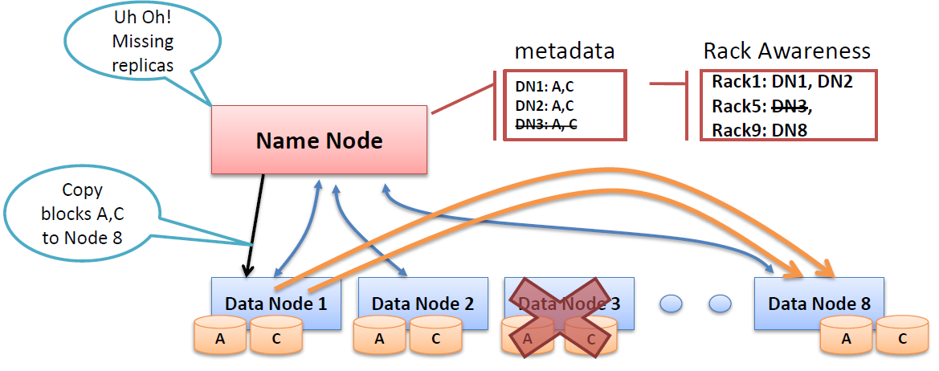
Missing Replicas
2
4
3
6
1
5

Slide 45
Map Reduce

